Slide 1
Prediction with GNNs

Slide 2




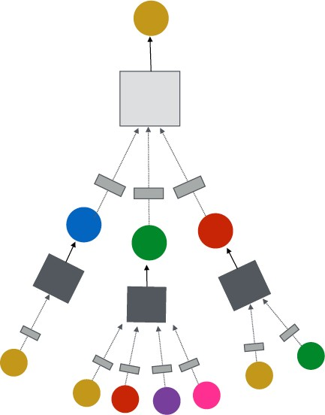


J. You, R. Ying, J. Leskovec. Design Space of Graph Neural Networks, NeurIPS 2020
TARGET NODE
B
(5) Learning objective
A
C
D
E
INPUT GRAPH
F
Next: How do we train a GNN?

Slide 3

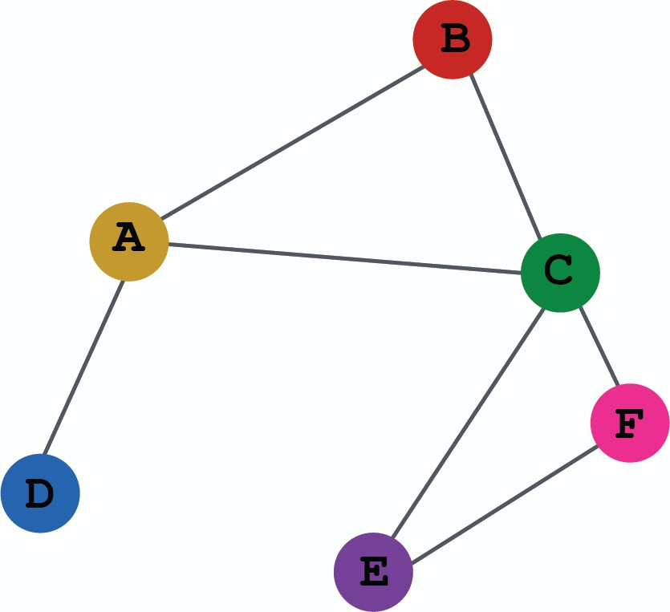
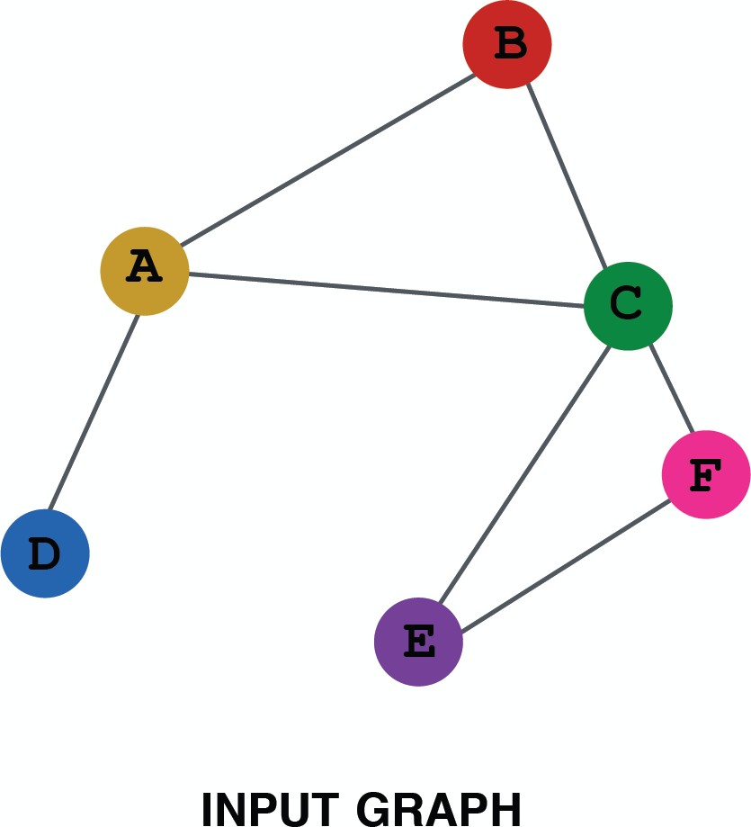
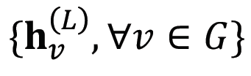
So far what we have covered
Evaluation metrics
Input Graph
Graph Neural Network
Node embeddings
Prediction head
Predictions
Labels
Loss function
Output of a GNN: set of node embeddings

Slide 4
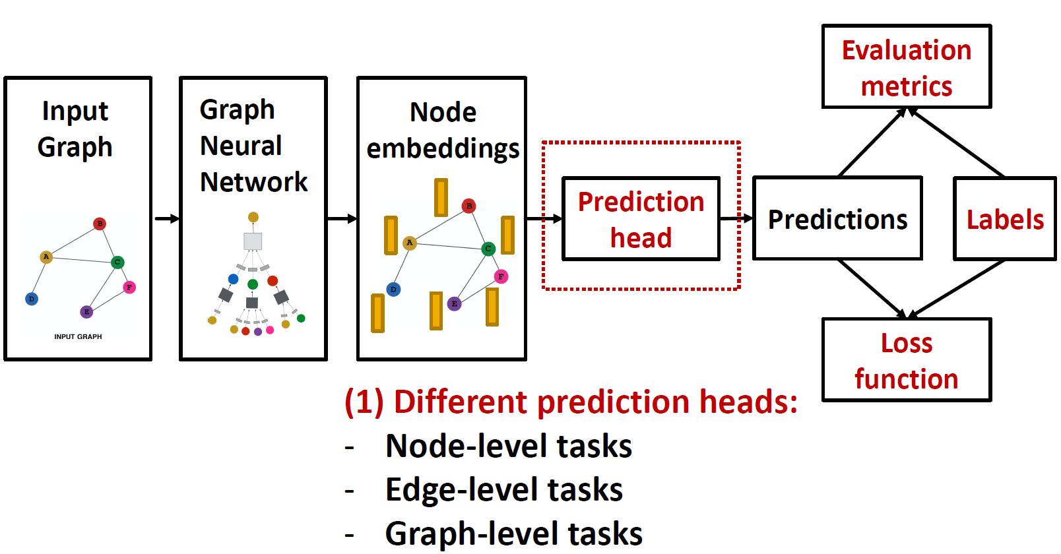

Slide 5
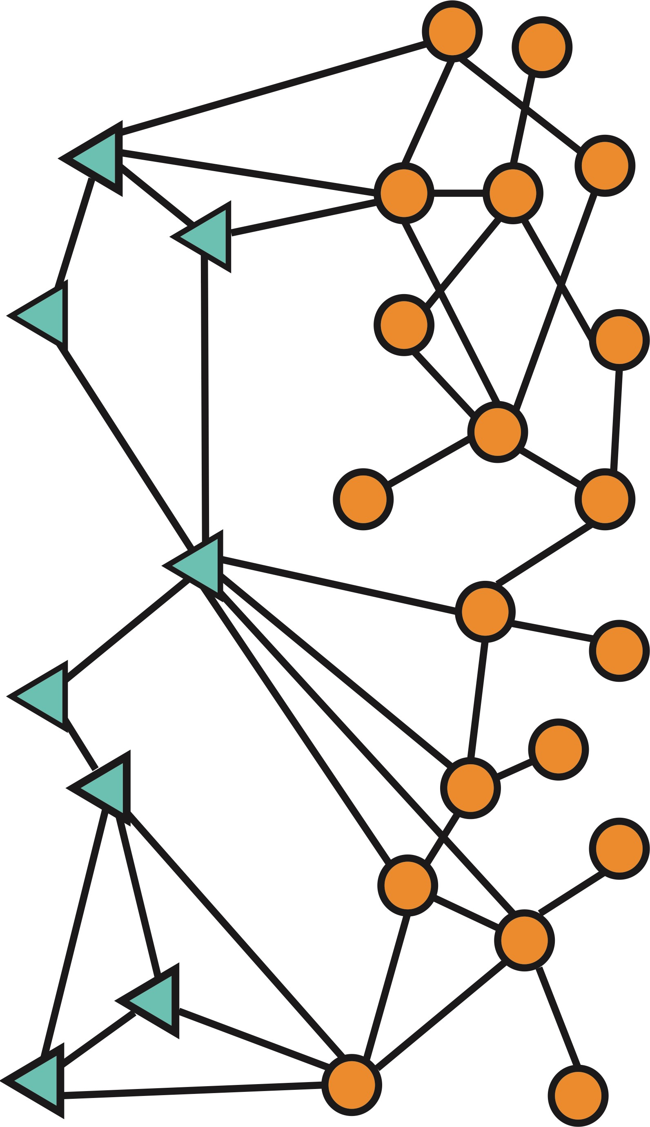
Idea: Different task levels require different prediction heads
Node-level prediction
Graph-level prediction
Edge-level prediction
Notes:
? Prediction head

Slide 6
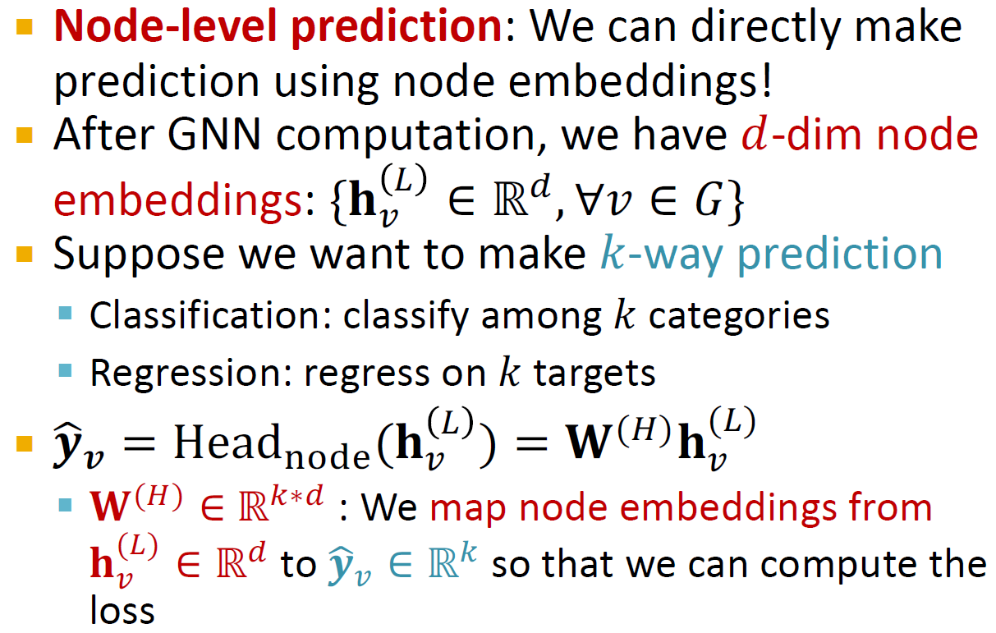

Slide 7
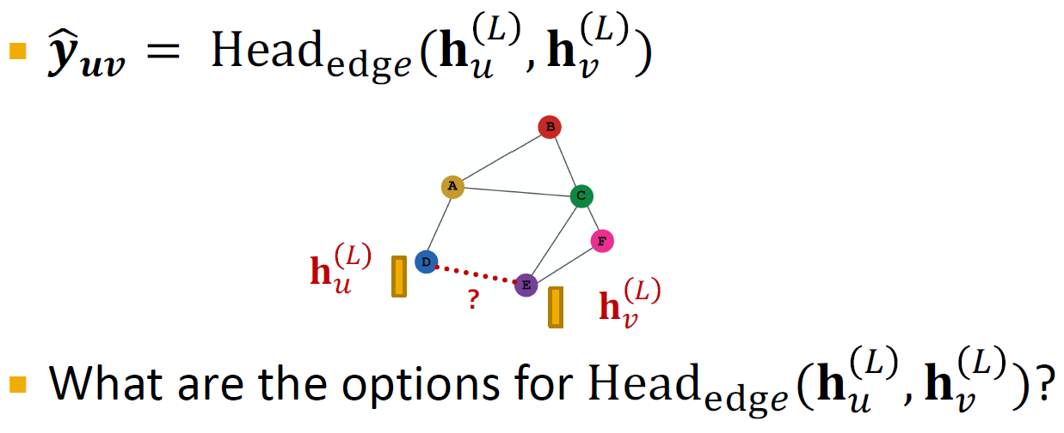
Edge-level prediction: Make prediction using pairs of node embeddings
Suppose we want to make 𝑘-way prediction

Slide 8
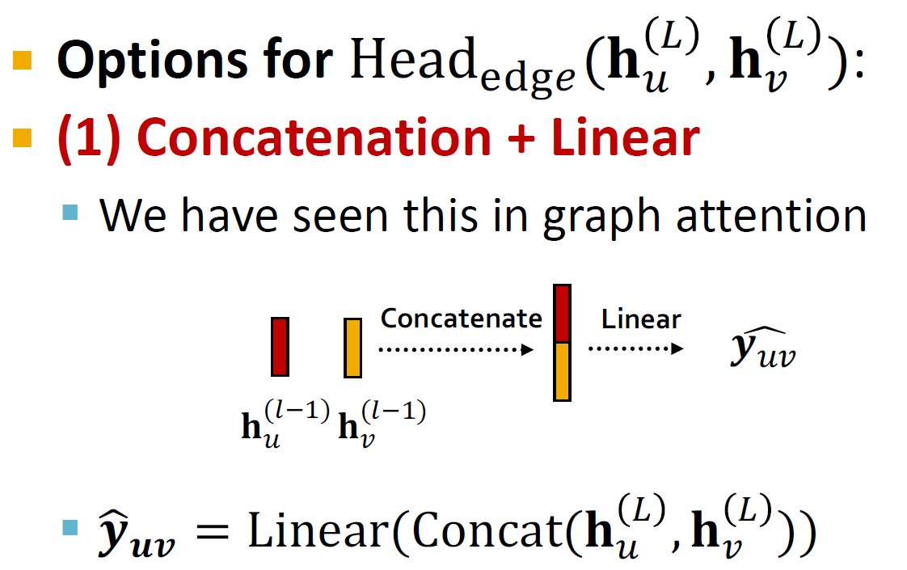
Here Linear(⋅) will map 2𝑑-dimensional embeddings (since we concatenated embeddings) to 𝑘-dim embeddings (𝑘-way prediction)

Slide 9
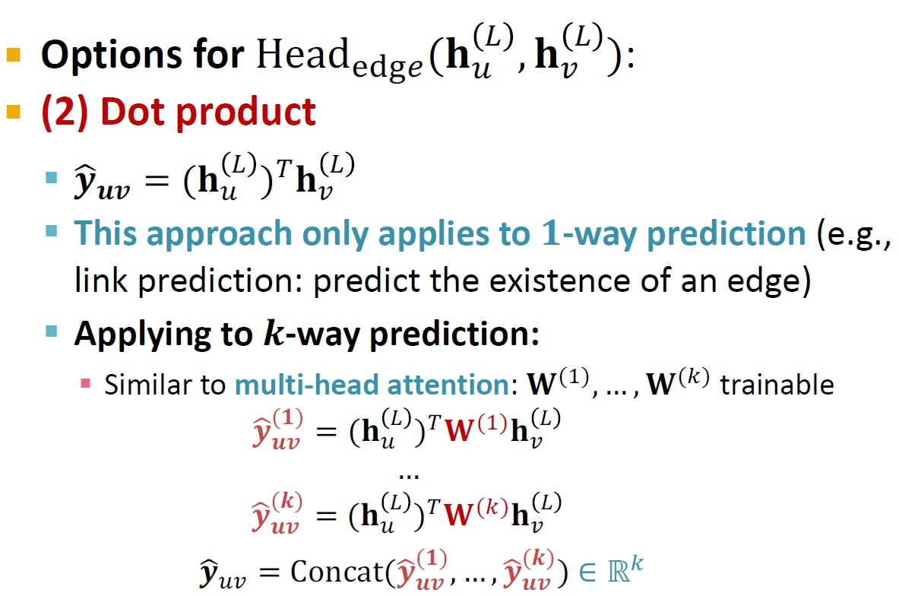
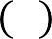
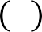
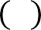
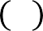
Options for Head!"#$(𝐡 & , 𝐡 & ):
% '
(2) Dot product
𝒚!_{𝒖𝒗} = (𝐡 $ )%𝐡 $
# &
This approach only applies to 𝟏-way prediction (e.g., link prediction: predict the existence of an edge)
Applying to 𝒌-way prediction:
Similar to multi-head attention: 𝐖^{(#)}, … , 𝐖^{(%)} trainable
𝒚+^{(𝟏)} = (𝐡 * )⁺𝐖^{(#)}𝐡 *
𝒖𝒗 ) ,
…
𝒚+^{(𝒌)} = (𝐡 * )⁺𝐖^{(%)}𝐡 *
𝒖𝒗 ) ,
𝒚+_{),} = Concat(𝒚+^{(𝟏)}, … , 𝒚+^{(𝒌)}) ∈ ℝ%
𝒖𝒗 𝒖𝒗

Slide 10
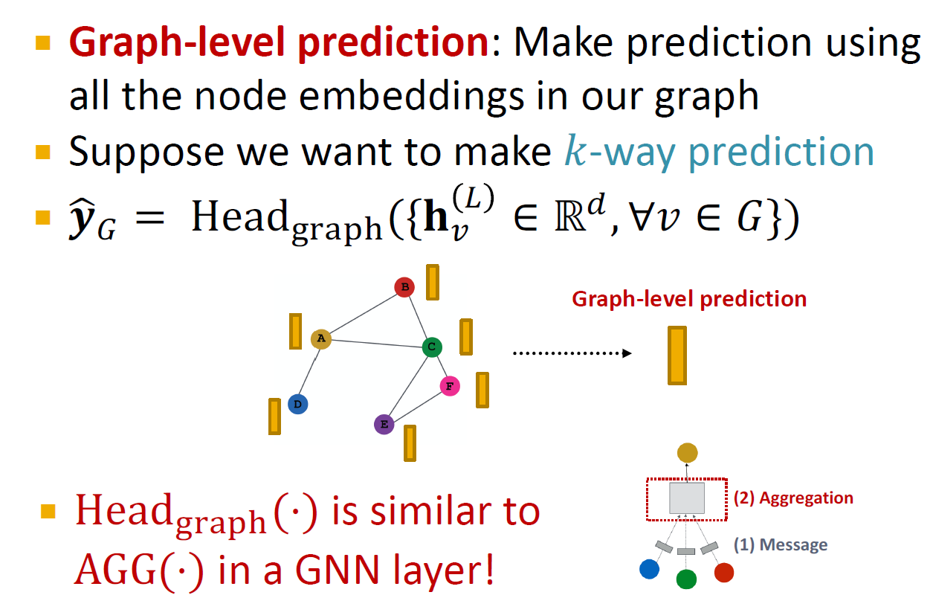
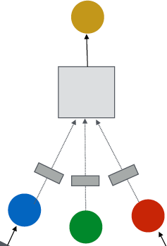
Graph-level prediction: Make prediction using all the node embeddings in our graph
Suppose we want to make 𝑘-way prediction
𝒚-₀ = Head₋₁₂₃₄({𝐡 " ∈ ℝ#, ∀𝑣 ∈ 𝐺})
!
Graph-level prediction
Head₋₁₂₃₄(⋅) is similar to
AGG(⋅) in a GNN layer!
(2) Aggregation
(1) Message

Slide 11
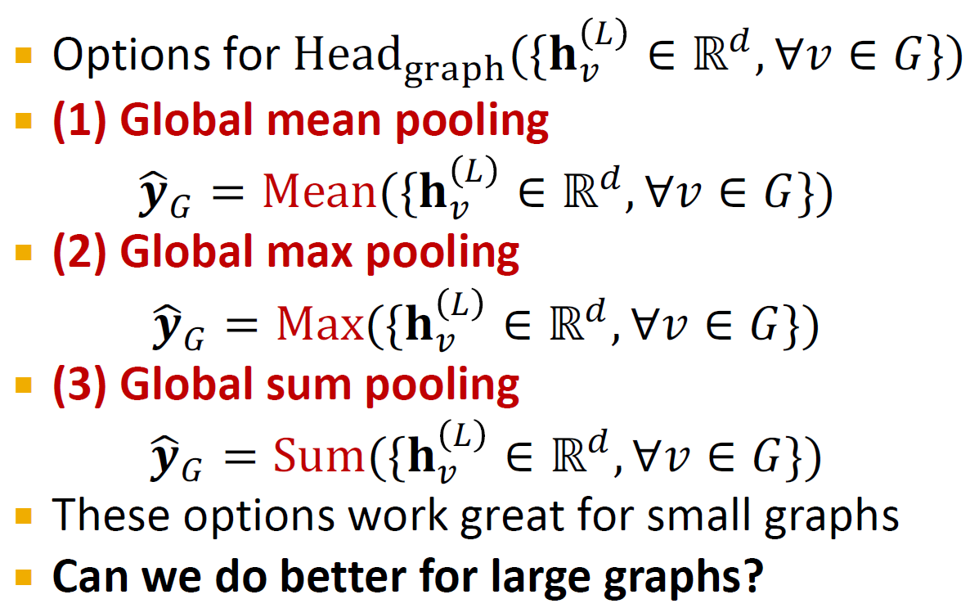
K. Xu*, W. Hu*, J. Leskovec, S. Jegelka. How Powerful Are Graph Neural Networks, ICLR 2019
Options for Head₋₁₂₃₄({𝐡 " ∈ ℝ#, ∀𝑣 ∈ 𝐺})
!
(1) Global mean pooling
𝒚-₀ = Mean({𝐡 " ∈ ℝ#, ∀𝑣 ∈ 𝐺})
!
(2) Global max pooling
𝒚-₀ = Max({𝐡 " ∈ ℝ#, ∀𝑣 ∈ 𝐺})
!
(3) Global sum pooling
𝒚-₀ = Sum({𝐡 " ∈ ℝ#, ∀𝑣 ∈ 𝐺})
!
These options work great for small graphs
Can we do better for large graphs?

Slide 12

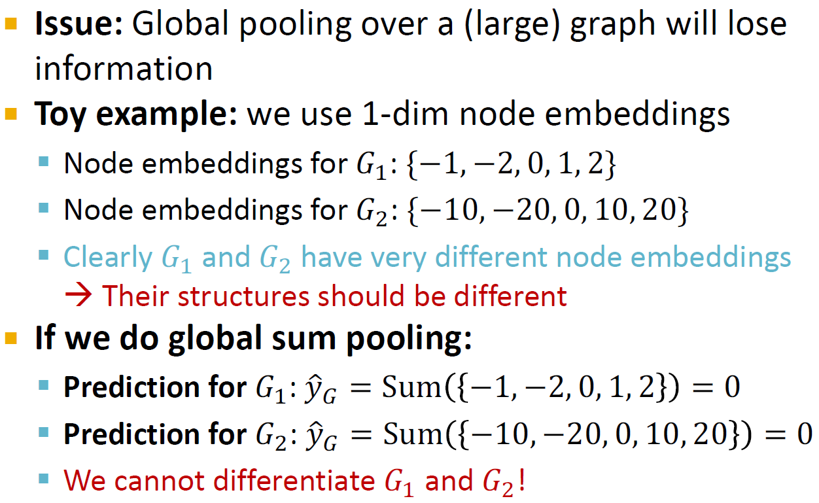
Issue: Global pooling over a (large) graph will lose information
Toy example: we use 1-dim node embeddings
Node embeddings for 𝐺': {−1, −2, 0, 1, 2}
Node embeddings for 𝐺₍: {−10, −20, 0, 10, 20}
Clearly 𝐺' and 𝐺₍ have very different node embeddings
→ Their structures should be different
If we do global sum pooling:
Prediction for 𝐺': 𝑦1₎ = Sum −1, −2, 0, 1, 2 = 0
Prediction for 𝐺₍: 𝑦1₎ = Sum −10, −20, 0, 10, 20 = 0
We cannot differentiate 𝐺' and 𝐺₍!

Slide 13
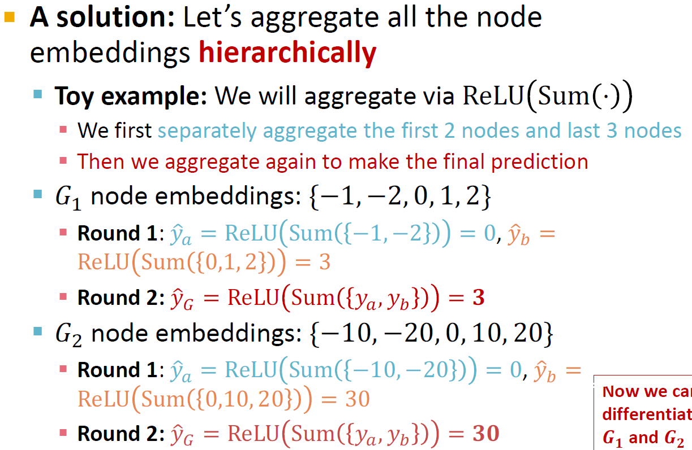
A solution: Let’s aggregate all the node embeddings hierarchically
Toy example: We will aggregate via ReLU Sum ⋅
We first separately aggregate the first 2 nodes and last 3 nodes
Then we aggregate again to make the final prediction
𝐺' node embeddings: {−1, −2, 0, 1, 2}
Round 1: 𝑦9. = ReLU Sum −1, −2 = 0, 𝑦9/ = ReLU Sum 0,1, 2 = 3
Round 2: 𝑦9₀ = ReLU Sum 𝑦., 𝑦/ = 𝟑
𝐺₍ node embeddings: {−10, −20, 0, 10, 20}
Round 1: 𝑦9. = ReLU Sum −10, −20 = 0, 𝑦9/ =
Now we can differentiate
𝑮_{𝟏} and 𝑮_{𝟐} !
ReLU Sum 0,10, 20 = 30
Round 2: 𝑦9₀ = ReLU Sum 𝑦., 𝑦/ = 𝟑𝟎

Slide 14
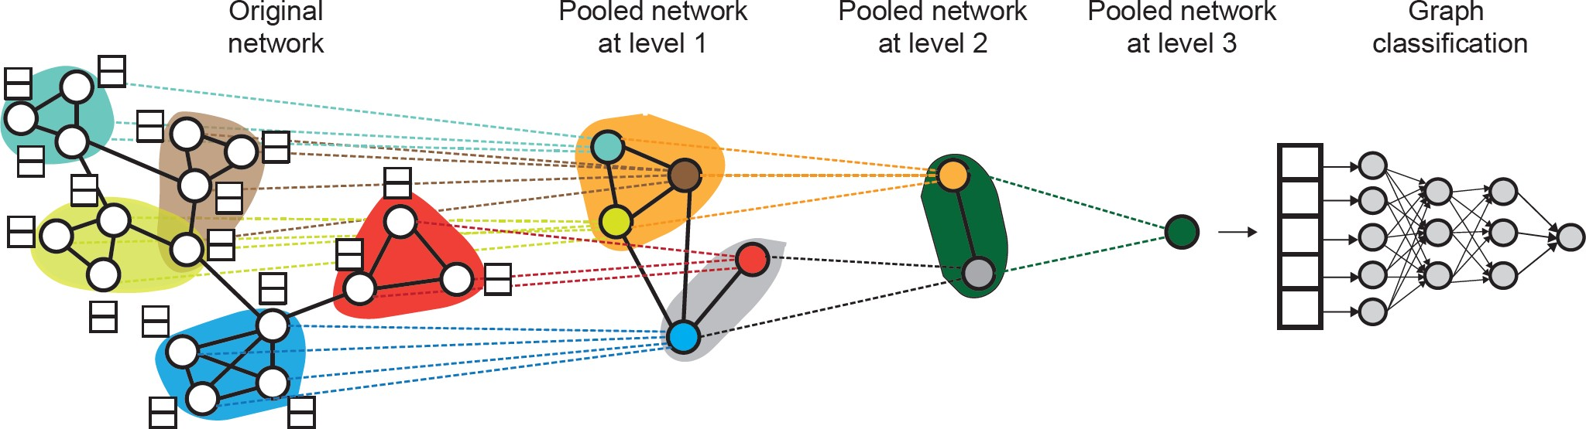
Ying et al. Hierarchical Graph Representation Learning with Differentiable Pooling, NeurIPS 2018
DiffPool idea:
Hierarchically pool node embeddings
Leverage 2 independent GNNs at each level
GNN A: Compute node embeddings
GNN B: Compute the cluster that a node belongs to
GNNs A and B at each level can be executed in parallel

Slide 15
DiffPool idea:
For each Pooling layer
Use clustering assignments from GNN B to aggregate node embeddings generated by GNN A
Create a single new node for each cluster, maintaining edges between clusters to generated a new pooled network
▪ Jointly train GNN A and GNN B

Slide 16
(2) Where does ground-truth come from?
- Supervised labels
- Unsupervised signals
Evaluation metrics
Input Graph
Graph Neural Network
Node embeddings
Prediction head
Predictions
Labels
Loss function

Slide 17
Supervised learning on graphs
Labels come from external sources
E.g., predict drug likeness of a molecular graph
Unsupervised learning on graphs
Signals come from graphs themselves
E.g., link prediction: predict if two nodes are connected
Sometimes the differences are blurry
We still have “supervision” in unsupervised learning
E.g., train a GNN to predict node clustering coefficient
An alternative name for “unsupervised” is “self- supervised”

Slide 18
Supervised labels come from the specific use cases. For example:
Node labels 𝒚_{𝒗}: in a citation network, which subject area does a node belong to
Edge labels 𝒚_{𝒖𝒗}: in a transaction network, whether an edge is fraudulent
Graph labels 𝒚_{G}: among molecular graphs, the drug likeness of graphs
Advice: Reduce your task to node / edge / graph labels, since they are easy to work with
E.g., we knew some nodes form a cluster. We can treat the cluster that a node belongs to as a node label

Slide 19
The problem: sometimes we only have a graph, without any external labels
The solution: “self-supervised learning”, we can
find supervision signals within the graph.
For example, we can let GNN predict the following:
Node-level 𝒚_{v}. Node statistics: such as clustering coefficient, PageRank, …
Edge-level 𝒚_{uv}. Link prediction: hide the edge between two nodes, predict if there should be a link
Graph-level 𝒚_{G}. Graph statistics: for example, predict if two graphs are isomorphic
These tasks do not require any external labels!
40

Slide 20
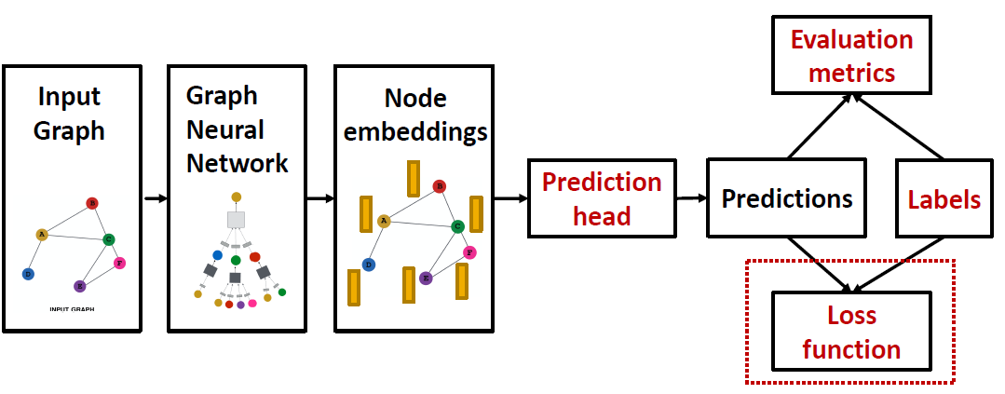
(3) How do we compute the final loss?
Classification loss
Regression loss

Slide 21
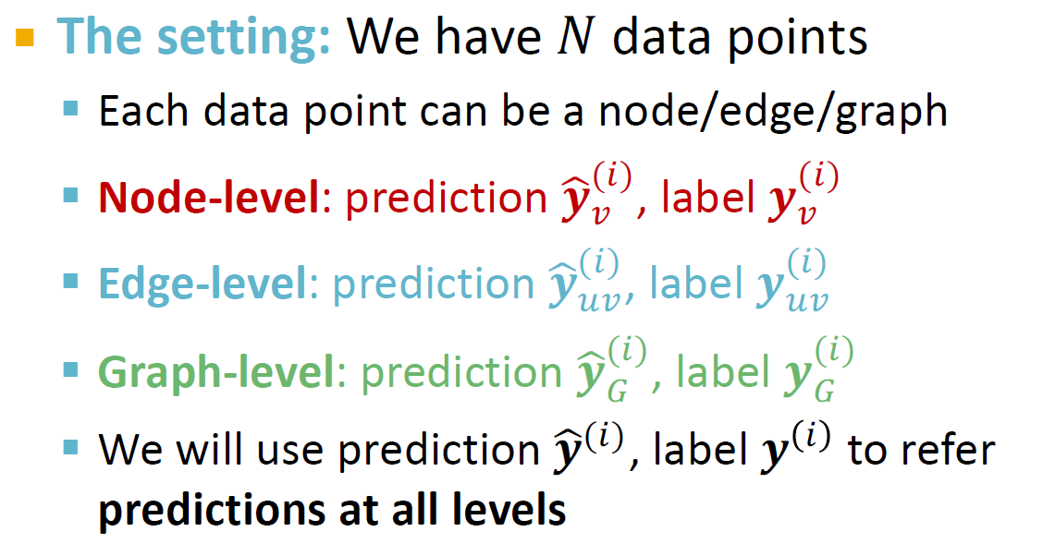

Slide 22
Classification: labels 𝒚 ^{i} with discrete value
E.g., Node classification: which category does a node belong to
Regression: labels 𝒚 ^{i} with continuous value
E.g., predict the drug likeness of a molecular graph
GNNs can be applied to both settings
Differences: loss function & evaluation metrics

Slide 23
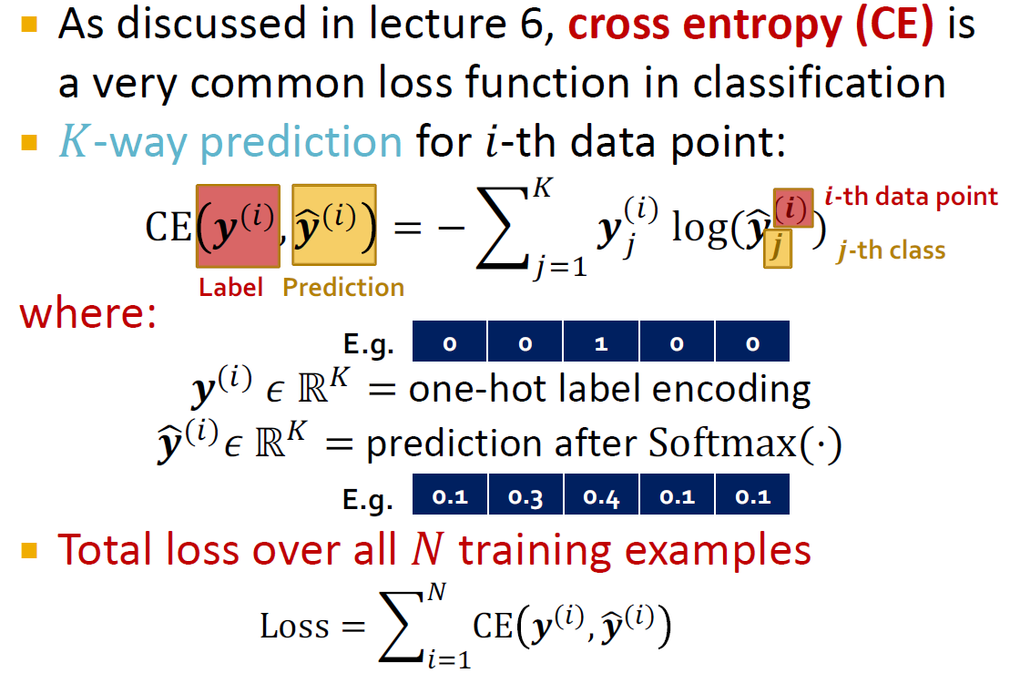
As discussed in lecture 6, cross entropy (CE) is a very common loss function in classification
𝐾-way prediction for 𝑖-th data point:
_{CE 𝒚}(1)_{, 𝒚-}(1)
4
= − B 𝒚₂ log(𝒚-
𝒊-th data point
(1)
(𝒊)
𝒋
⁾ 𝒋-th class
23!
where:
Label Prediction
E.g.
0 | 0 | 1 | 0 | 0
𝒚⁽¹⁾ 𝜖 ℝ⁴ = one-hot label encoding
𝒚-⁽¹⁾𝜖 ℝ⁴ = prediction after Softmax(⋅)
E.g.
Total loss over all 𝑁 training examples
0.1 | 0.3 | 0.4 | 0.1 | 0.1
-
_{CE 𝒚}(*)_{, 𝒚3}(*)
Loss = 0
*+,

Slide 24

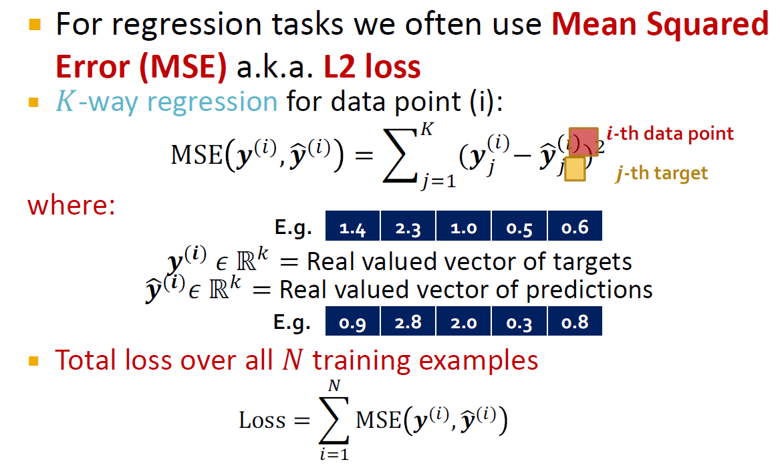
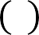
For regression tasks we often use Mean Squared Error (MSE) a.k.a. L2 loss
𝐾-way regression for data point (i):
3
= ( (𝒚₂ − 𝒚₂
2+,
𝒊-th data point
(*)
& *
4
MSE 𝒚^{(*)}, 𝒚&^{(*)}
)
𝒋-th target
where:
E.g.
1.4 | 2.3 | 1.0 | 0.5 | 0.6
𝒚^{(𝒊)} 𝜖 ℝ⁵ = Real valued vector of targets
𝒚&^{(𝒊)}𝜖 ℝ⁵ = Real valued vector of predictions
E.g.
Total loss over all 𝑁 training examples
3
Loss = J MSE 𝒚⁽¹⁾, 𝒚+⁽¹⁾
12#
0.9 | 2.8 | 2.0 | 0.3 | 0.8

Slide 25
(4) How do we measure the success of a GNN?
Accuracy
ROC AUC
Evaluation metrics
Input Graph
Graph Neural Network
Node embeddings
Prediction head
Predictions
Labels
Loss function

Slide 26
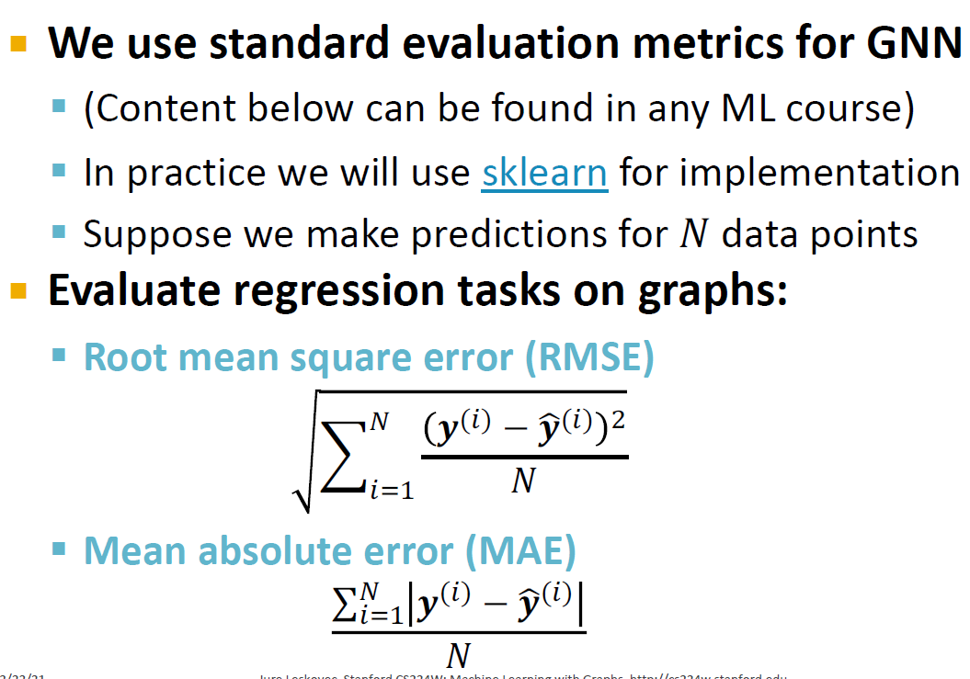
We use standard evaluation metrics for GNN
(Content below can be found in any ML course)
In practice we will use sklearn for implementation
Suppose we make predictions for 𝑁 data points
Evaluate regression tasks on graphs:
Root mean square error (RMSE)
-
_{𝒚}(*) _{− 𝒚3}(*) 4
0
*+,
𝑁
Mean absolute error (MAE)
∑- _{𝒚}(*) _{− 𝒚3}(*)
*+,
𝑁

Slide 27
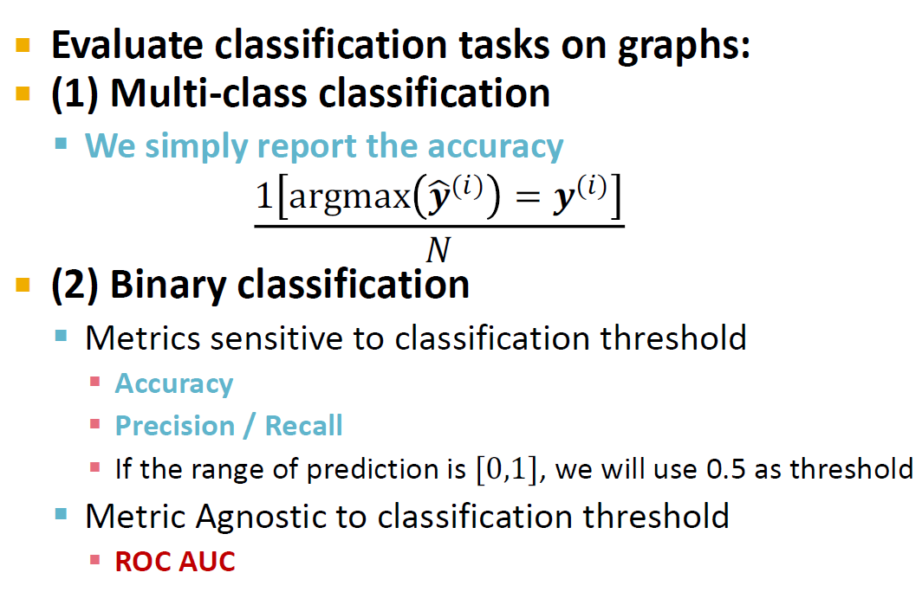
Evaluate classification tasks on graphs:
(1) Multi-class classification
We simply report the accuracy
1 argmax 𝒚!⁽⁺⁾
_{= 𝒚}(+)
𝑁
(2) Binary classification
Metrics sensitive to classification threshold
Accuracy
Precision / Recall
If the range of prediction is [0,1], we will use 0.5 as threshold
Metric Agnostic to classification threshold
ROC AUC

Slide 28
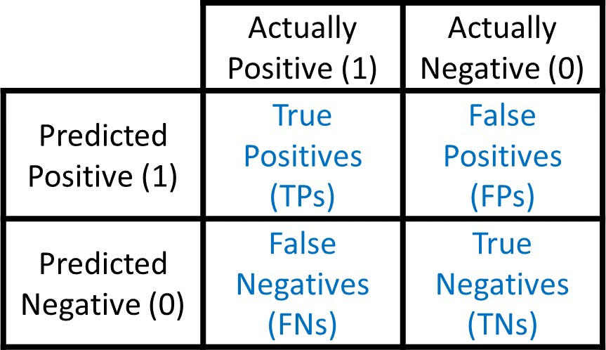
Accuracy:
TP + TN
₌ TP + TN
TP + TN + FP + FN
Precision (P):
TP
|Dataset|
Confusion matrix
TP + FP
Recall (R):
TP TP + FN
F1-Score:
2P ∗ R
P + R
Sklearn Classification Report

Slide 29
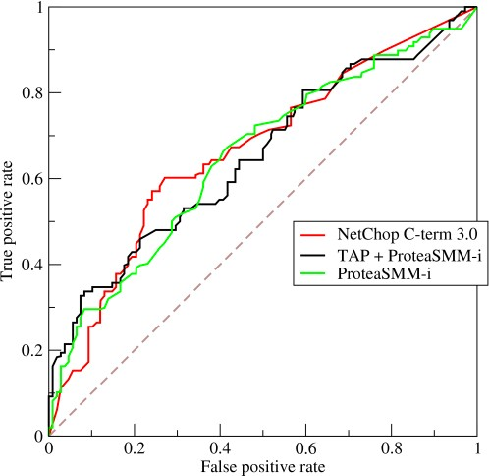
ROC Curve: Captures the tradeoff in TPR and FPR as the classification threshold is varied for a binary classifier.
TP
TPR = Recall =
TP + FN
TPR
FP
^{FPR =} FP + TN
Note: the dashed line represents performance of a random classifier
Image Credit: Wikipedia
FPR

Slide 30
Content Credit: Wikipedia
ROC AUC: Area under the ROC Curve.
Intuition: The probability that a classifier will rank a
randomly chosen positive instance higher than a randomly chosen negative one

Slide 31
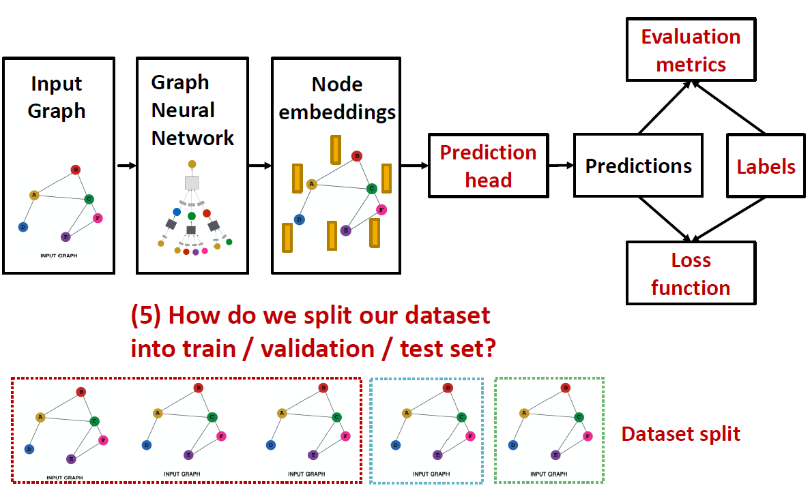
Input Graph
Graph Neural Network
Node embeddings
Prediction head
Predictions
Labels
Loss function
(5) How do we split our dataset into train / validation / test set?
Dataset split

Slide 32
Fixed split: We will split our dataset once
Training set: used for optimizing GNN parameters
Validation set: develop model/hyperparameters
Test set: held out until we report final performance
A concern: sometimes we cannot guarantee that the test set will really be held out
Random split: we will randomly split our
dataset into training / validation / test
We report average performance over different random seeds

Slide 33






Suppose we want to split an image dataset
Image classification: Each data point is an image
Here data points are independent
Image 5 will not affect our prediction on image 1
Training Validation Test
2
1
3
6
5
4

Slide 34






Splitting a graph dataset is different!
Node classification: Each data point is a node
Here data points are NOT independent
Node 5 will affect our prediction on node 1, because it will participate in message passing → affect node 1’s embedding
Training Validation Test
2
1
3
6
5
4
What are our options?

Slide 35






Solution 1 (Transductive setting): The input graph can be observed in all the dataset splits (training, validation and test set).
We will only split the (node) labels
At training time, we compute embeddings using the entire graph, and train using node 1&2’s labels
At validation time, we compute embeddings using the entire graph, and evaluate on node 3&4’s labels
Training
Validation Test
2
1
3
6
5
4

Slide 36
Solution 2 (Inductive setting): We break the edges between splits to get multiple graphs
Now we have 3 graphs that are independent. Node 5 will not affect our prediction on node 1 any more
At training time, we compute embeddings using the graph over node 1&2, and train using node 1&2’s labels
At validation time, we compute embeddings using the graph over node 3&4, and evaluate on node 3&4’s labels
Training
Validation Test
2
1
3
6
5
4

Slide 37
Transductive setting: training / validation / test sets are on the same graph
The dataset consists of one graph
The entire graph can be observed in all dataset splits, we only split the labels
Only applicable to node / edge prediction tasks
Inductive setting: training / validation / test sets are on different graphs
The dataset consists of multiple graphs
Each split can only observe the graph(s) within the split. A successful model should generalize to unseen graphs
Applicable to node / edge / graph tasks

Slide 38
Transductive node classification
All the splits can observe the entire graph structure, but can only observe the labels of their respective nodes
Training
Validation Test
Inductive node classification
Suppose we have a dataset of 3 graphs
Each split contains an independent graph
Training Validation Test

Slide 39
Only the inductive setting is well defined for
graph classification
Because we have to test on unseen graphs
Suppose we have a dataset of 5 graphs. Each split will contain independent graph(s).
Training
Validation
Test

Slide 40















Goal of link prediction: predict missing edges
Setting up link prediction is tricky:
Link prediction is an unsupervised / self-supervised task. We need to create the labels and dataset splits on our own
Concretely, we need to hide some edges from the GNN and the let the GNN predict if the edges exist
2
2
2
1
3
1
3
1
3
?
4
5 4
Original graph
5 4
Input graph to GNN
5
Predictions made by GNN

Slide 41





2
1
3
Message edges
Supervision edges
5 4
Original graph
For link prediction, we will split edges twice
Step 1: Assign 2 types of edges in the original graph
Message edges: Used for GNN message passing
Supervision edges: Use for computing objectives
After step 1:
Only message edges will remain in the graph
Supervision edges are used as supervision for edge predictions made by the model, will not be fed into GNN!

Slide 42
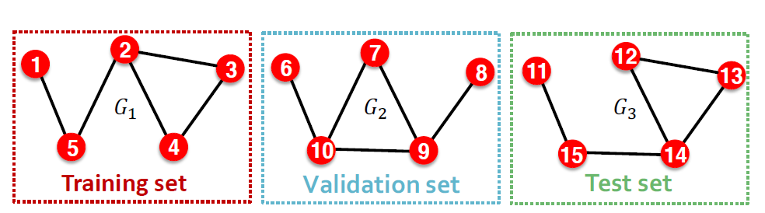
Step 2: Split edges into train / validation / test
Option 1: Inductive link prediction split
Suppose we have a dataset of 3 graphs. Each inductive split will contain an independent graph

Slide 43
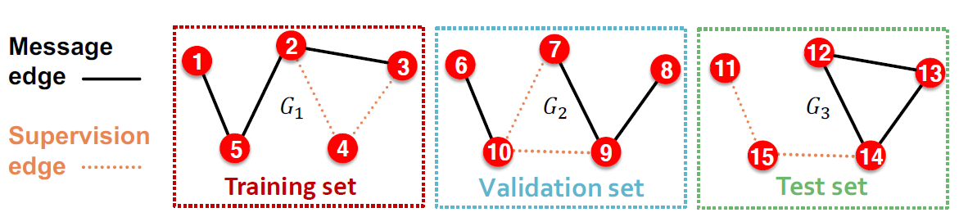















Step 2: Split edges into train / validation / test
Option 1: Inductive link prediction split
Suppose we have a dataset of 3 graphs. Each inductive split will contain an independent graph
In train or val or test set, each graph will have 2 types of edges: message edges + supervision edges
Supervision edges are not the input to GNN
Message
2
7
12
edge
1
3
6
8
11
13
𝐺!
𝐺$
𝐺%
15 14
Test set
Supervision edge
5 4
Training set
10 9
Validation set

Slide 44





Option 2: Transductive link prediction split:
This is the default setting when people talk about link prediction
Suppose we have a dataset of 1 graph
2
1
3
5
4

Slide 45





Option 2: Transductive link prediction split:
By definition of “transductive”, the entire graph can be observed in all dataset splits
But since edges are both part of graph structure and the supervision, we need to hold out validation / test edges
To train the training set, we further need to hold out supervision edges for the training set
2
1
3
5 4
Next: we will show the exact settings

Slide 46




















Option 2: Transductive link prediction split:
2
1
3
5 4
The original graph
2
2
2
1
3
1
3
1
3
5 4
(1) At training time:
Use training message
edges to predict training supervision edges
5 4
(2) At validation time: Use training message edges & training supervision edges to predict validation edges
5 4
(3) At test time:
Use training message
edges & training supervision edges & validation edges to predict test edges

Slide 47
Option 2: Transductive link prediction split:
Why do we use growing number of edges?
After training, supervision edges are known to GNN. Therefore, an ideal model should use supervision edges in message passing at validation time.
The same applies to the test time.
2
2 2
1
3
1
3
1
3
5 4
(1) At training time:
Use training message
edges to predict training supervision edges
5 4
(2) At validation time: Use training message edges & training supervision edges to predict validation edges
5 4
(3) At test time:
Use training message
edges & training supervision edges & validation edges to predict test edges

Slide 48










Summary: Transductive link prediction split:
2
2
Training message edges Training supervision edges Validation edges
Test edges
1
3
1
3
Split
5 4
The original graph
5 4
Split Graph with 4 types of edges
Note: Link prediction settings are tricky and complex. You may find papers do link prediction differently. But if you follow our reasoning steps, this should be the right way to implement link prediction
Luckily, we have full support in DeepSNAP and GraphGym

Slide 49
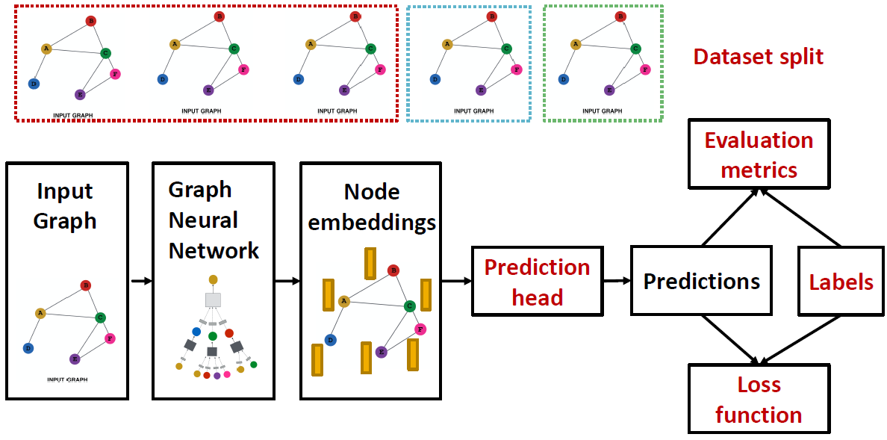
Evaluation metrics
Input Graph
Graph Neural Network
Node embeddings
Prediction head
Predictions
Labels
Loss function
Implementation resources:
DeepSNAP provides core modules for this pipeline
GraphGym further implements the full pipeline to facilitate GNN design

Slide 50
We introduce a general perspective for GNNs
GNN Layer:
Transformation + Aggregation
Classic GNN layers: GCN, GraphSAGE, GAT
Layer connectivity:
The over-smoothing problem
Solution: skip connections
Graph Augmentation:
Feature augmentation
Structure augmentation
Learning Objectives
The full training pipeline of a GNN

